Slide 1
INTRODUCTION
BMW SALES DATA
PRESENTED BY GOWTHAM R
I MBA A
SA COLOLEGE OF ARTS AND SCIENCE

Slide 2
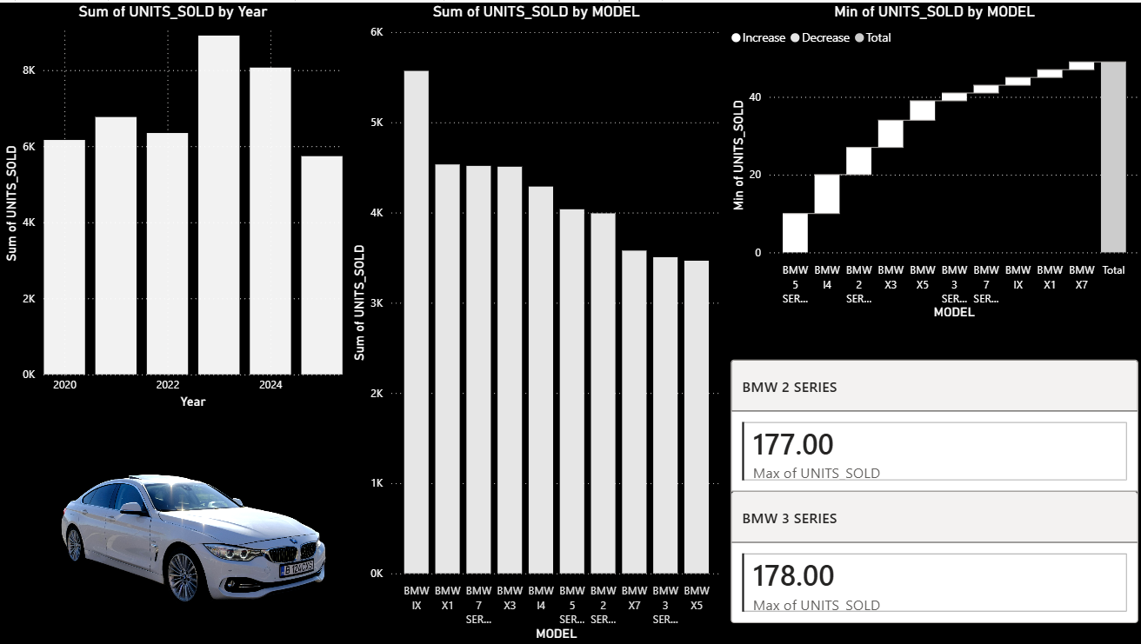

Slide 3
Sales Trend & Model Performance
Shows sales performance across different years.
Overall sales trend is increasing with a peak in recent years.
BMW iX and BMW X1 are the top-selling models.
Some models have lower sales, showing varied customer demand.
Helps identify high-performing and low-performing models.
Useful for understanding product-wise sales growth.

Slide 4
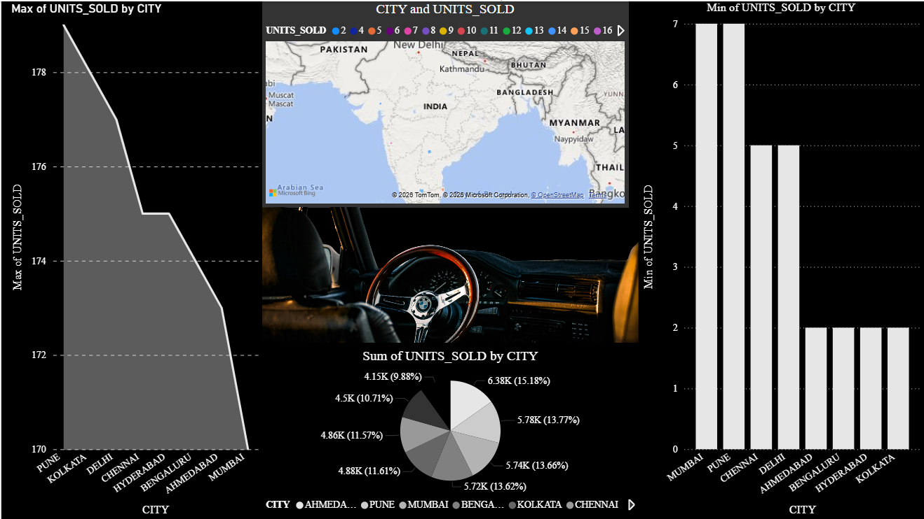

Slide 5
City-Wise Sales Analysis
Displays sales performance across different cities.
Metro and Tier-1 cities contribute the highest sales.
Pune and Bengaluru show strong peak sales.
Some cities have stable sales, while others show fluctuations.
Sales are fairly evenly distributed across cities.
Helps analyze regional demand and market reach.

Slide 6
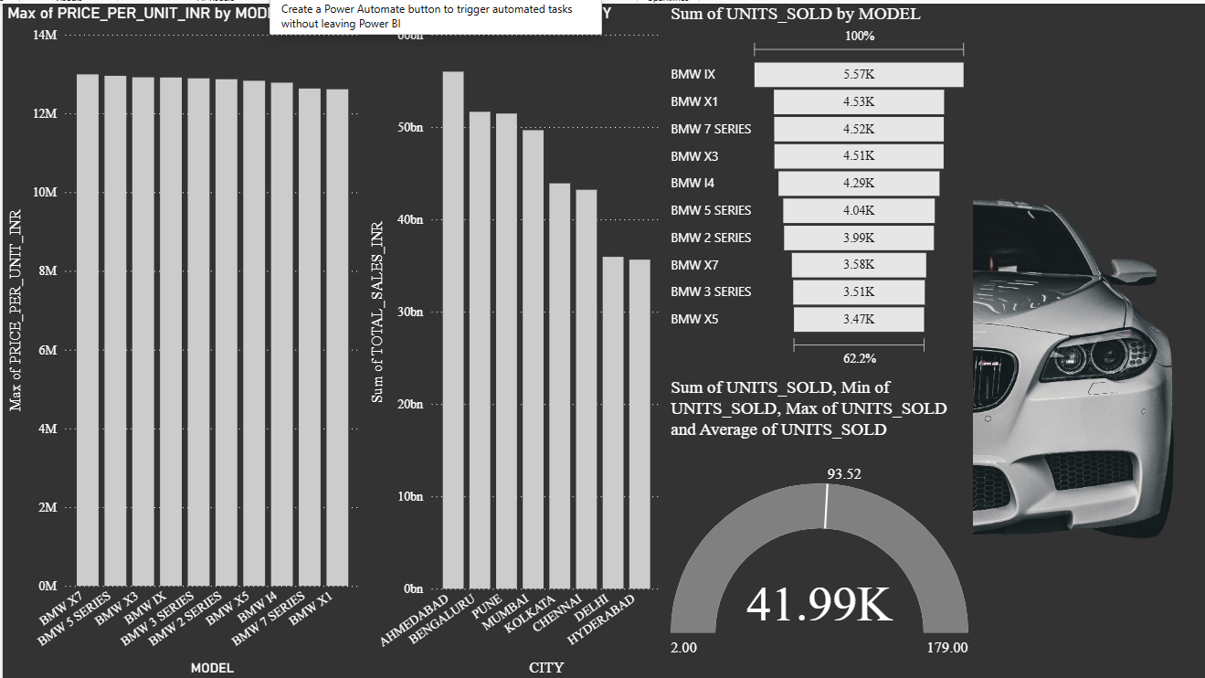

Slide 7
Pricing, Revenue & Overall Sales
Shows maximum price per unit for each BMW model.
BMW iX and BMW X7 have the highest prices.
Ahmedabad and Bengaluru generate the highest total revenue.
BMW iX leads in total units sold.
Total units sold are around 42K units.
Highlights BMW’s strong premium positioning and revenue performance.

Slide 8
Conclusion
The dashboards show a strong and consistent sales performance across years, cities, and models.
BMW iX, X1, and other SUV models are the key drivers of both unit sales and revenue.
Premium pricing is well maintained, especially for high-end models like BMW iX and X7.
Metro and Tier-1 cities such as Ahmedabad, Bengaluru, Pune, and Mumbai contribute the most to sales.
Sales are well distributed across regions and models, reducing business risk.
Total units sold (~42K) indicate a healthy market demand for BMW vehicles.
Overall, the data reflects a balanced, stable, and premium-focused sales strategy.

